Slide 1
Advanced Programming
Lecture 1
Dr. Cristina Muntean
cmuntean@ncirl.ie
Notes:
Course description
September 2004
NCI BSHSS2 SWD3

Slide 2
NetBeans
Integrated Development Environment (IDE)
Notes:
Course description
September 2004
NCI BSHSS2 SWD3

Slide 3
1.1 Integrated Development Environment (IDE)
IDE is a set of tools that aids application development.
Provides an environment where tools needed for source code editing, compiling, testing, debugging are seamlessly integrated.
Most IDEs have tools that allow you to:
  Write and edit source code
  See errors as you type
  See highlighted code syntax
  Compile code
  Browse class structures
  Use drag-and-drop utilities for easy building of features, such as graphic objects or creating database connections
In adition, some IDEs do:
  Automatically create classes, methods, and properties
  Provide code-completion as you type
  Integrate with web application servers, such as Apache Tomcat
Dr. Cristina Muntean (NCI)
Notes:
Course description
September 2004
NCI BSHSS2 SWD3

Slide 4
1.2 Advantages of using IDE
When developing applications it saves you time by managing windows, settings and data.
Drag-and-drop features make creating GUI components or accessing databases easy
Highlighted code and debugging features alert you to errors in your code
moving from one phase of code development to the other is very simple. User need not be bothered about the tool interfaces
Many people learn to program using a simple text editor, but most of them end up using an integrated development environment (IDE) for building applications !
Dr. Cristina Muntean (NCI)
Notes:
Course description
September 2004
NCI BSHSS2 SWD3

Slide 5
1.3 IDEs for Java platform
Sun Microsystems supports three IDEs for the Java platform:
  NetBeans (open-source)
  Sun Java Studio Creator
  Sun Java Studio Enterprise.
IBM supports:
  Eclipse (open-source)
  Visual Age for Java
Borland supports:
  JBuilder
Dr. Cristina Muntean (NCI)
Notes:
Course description
September 2004
NCI BSHSS2 SWD3

Slide 6
1.3 NetBeans IDE: Main features
It is open source (free for commercial and noncommercial use) and is supported by Sun Microsystems.
open source => continual improvement => slight differences between various versions
It enables developers to rapidly create
  web, enterprise, desktop, and mobile applications using the Java platform,
  PHP, JavaScript and Ajax, Ruby and Ruby on Rails, Groovy, and C/C++.
Provides the services common to desktop applications such as window and menu management, settings storage, etc.
Provides tools for:
  Source Code Editor, GUI Builder, Database support
Dr. Cristina Muntean (NCI)
Notes:
Course description
September 2004
NCI BSHSS2 SWD3

Slide 7
1.3 NetBeans IDE: Getting Familiar
Download a stable version from the NetBeans web site : NetBeans IDE with JDK Bundle
  Link: http://java.sun.com/javase/downloads/netbeans.html
  http://netbeans.org/downloads/index.html
Install the NetBeans kit
Start the application => You will notice the welcome screen
  In Windows: Start-> Programs -> NetBeans -> NetBeans IDE
Add the JDK javadoc (Java SE 6 or Java SE 7):
  Choose Tools > Java Platform manager. Select Javadoc. In the Javadoc tab, click Add ZIP/Folder and specify the location of the Javadoc files.
In NetBeans, we work within the context of a project
A project consists of:
  an organized group of source files and associated metadata;
  project-specific properties files;
  all the tools you'll need to write, compile, test, and debug your application.
Dr. Cristina Muntean (NCI)
Notes:
Course description
September 2004
NCI BSHSS2 SWD3

Slide 8
1.4 NetBeans: Exercise – A new application
Step 1: Create a project
Project Name: MotorCarsGarage
We want to develop an application to be used by the MotorCarsGarage company that sells second hand cars
The application should allow you to
  Print contact details about the MotorCarsGarage company
  Add/remove/ cars from the company list
  Display all the cars in the stock
Dr. Cristina Muntean (NCI)
Notes:
Course description
September 2004
NCI BSHSS2 SWD3

Slide 9

1.4 NetBeans: Exercise – A new application
Step 1: Create a project
Main steps:
  1. Create a new project in the NetBeans IDE:
    from the main menu, File =>New Project,
    select Categories: General and Projects: Java Application
    Press button Next
    Set the Name and Location of the project
      Project Name: MotorCarsGarage
      Project Location: your home (H:) drive
    Set Create Main class field: motorcarsgarage.MotorCarsGarage
    Press Finish button
Dr. Cristina Muntean (NCI)
Notes:
Course description
September 2004
NCI BSHSS2 SWD3

Slide 10
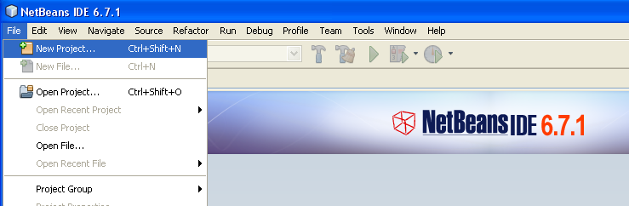
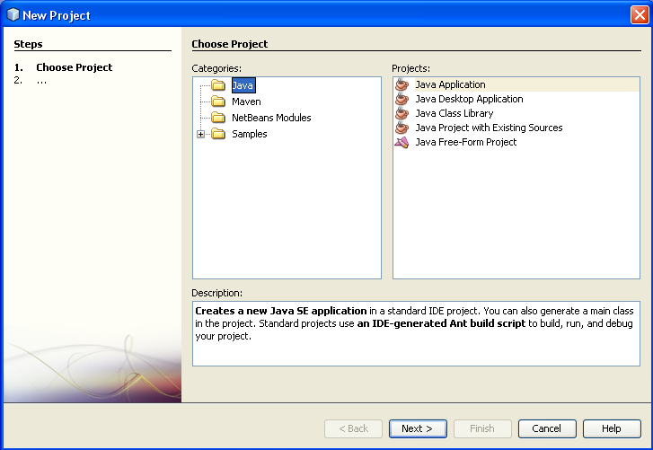
1.4 NetBeans: Exercise – A new application
Step 1: Create a project
Dr. Cristina Muntean (NCI)
Notes:
Course description
September 2004
NCI BSHSS2 SWD3

Slide 11
1.4 NetBeans: Exercise – A new application
Step 2: Edit your java files
The skeleton of your java application was created
Projects windows -> Source Pakages: all pakages and java files developed under this project
Main steps:
  2. Start to edit your source code
    we already have MainMotorCars class, but we need to write code in the main() method and other methods that we want to develop.
    Add the following code in the main() method
      System.out.println(“MotorCarsGarage”);
      System.out.println(“10, Drumcondra Road, Dubin 5”);
      System.out.println(“Phone: 563400”);
Dr. Cristina Muntean (NCI)
Notes:
Course description
September 2004
NCI BSHSS2 SWD3

Slide 12
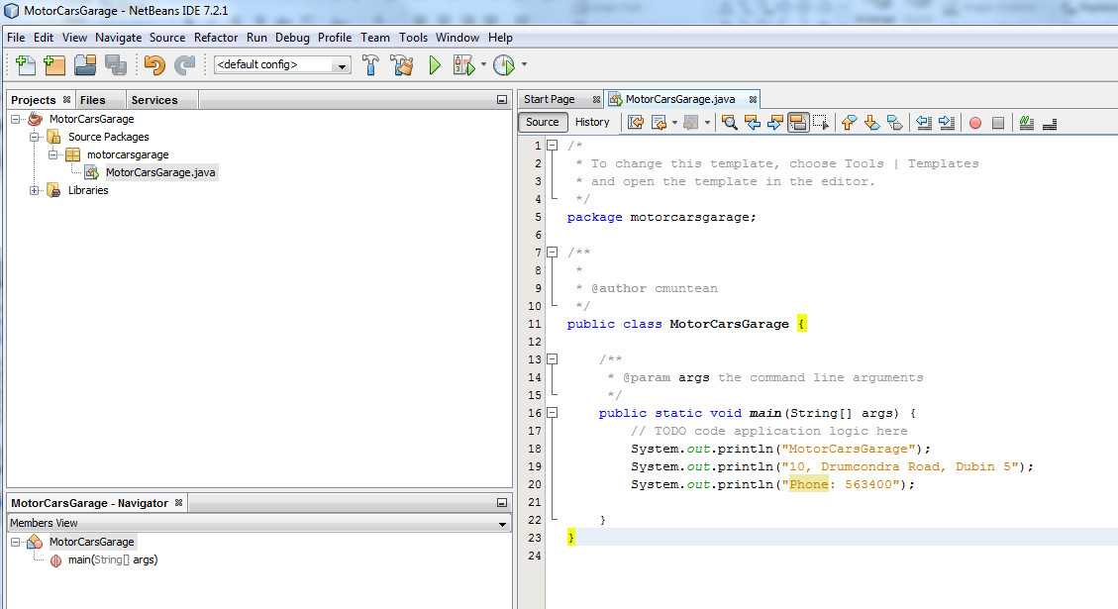
1.4 NetBeans: Exercise – A new application
Step 2: Edit your java files
Dr. Cristina Muntean (NCI)
Notes:
Course description
September 2004
NCI BSHSS2 SWD3

Slide 13
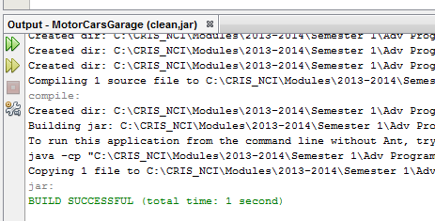
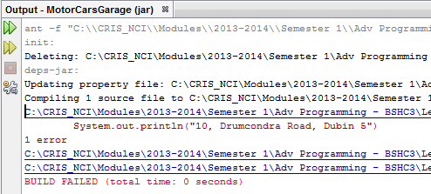
1.4 NetBeans: Exercise – A new application
Step 3: Compile your project
Main steps:
  3. Compiling the Java File(s)
    from the main menu, Run =>Build Main Project (F11)
    If successful, the message “BUILD SUCCESSFUL” appears in the Output Window
    If the build output concludes “BUILD FAILED”, you probably have a syntax error in your code.
    Errors are reported in the Output window as hyper-linked text. You double-click the hyper-link to navigate to the source of an error.
    After you fixed the error(s), once again choose Run - > Build Main Project.
Dr. Cristina Muntean (NCI)
Notes:
Course description
September 2004
NCI BSHSS2 SWD3

Slide 14
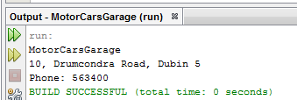
1.4 NetBeans: Exercise – A new application
Step 4: Compile your project
Now that you have built the project, you can run your program
Main steps:
  4. Running the program
    from the main menu, Run =>Run Main Project (F6),
    The output of the program is displayed in the Output Windows
Dr. Cristina Muntean (NCI)
Notes:
Course description
September 2004
NCI BSHSS2 SWD3

Slide 15
1.4 NetBeans: Exercise – A new application
Step 5: Create and Edit more java files
Your application may need to be extended with other Java classes or files
Main steps:
  5. Add/Write new Java classes to your project
    Create Car class
      File=>New File=> Java Class as class types => press Next button
      Set Class Name: Car, then press Finish button
    Edit the Car class: Project window and then click on Car.java
Dr. Cristina Muntean (NCI)
Notes:
Course description
September 2004
NCI BSHSS2 SWD3

Slide 16
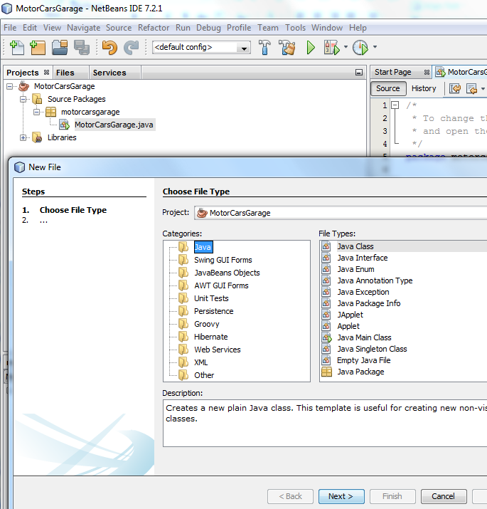
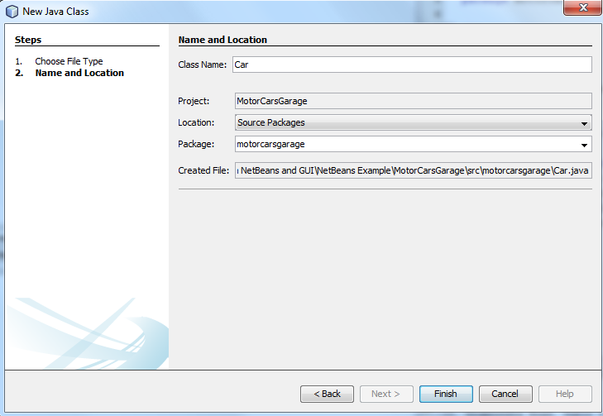
1.4 NetBeans: Exercise – A new application
Step 5: Create and Edit more java files
Dr. Cristina Muntean (NCI)
Notes:
Course description
September 2004
NCI BSHSS2 SWD3

Slide 17
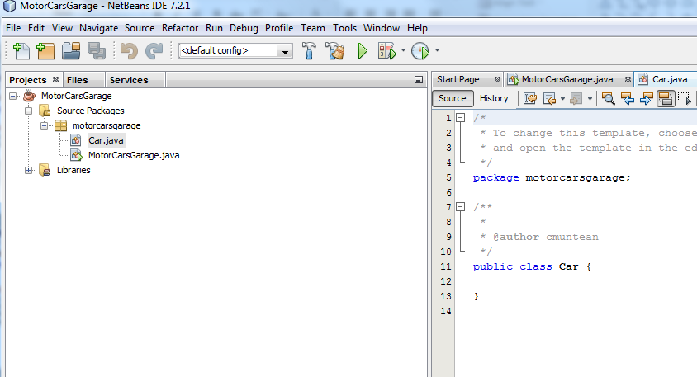
1.4 NetBeans: Exercise – A new application
Step 5: Create and Edit more java files
Skeleton of Car class was created and added to the project
Dr. Cristina Muntean (NCI)
Notes:
Course description
September 2004
NCI BSHSS2 SWD3

Slide 18
1.4 NetBeans: Exercise – A new application
Step 5: Create and Edit more java files
Edit the Car class
  Atributes:
    public String model;
    public String color;
    public int year;
  Constructor:
    Car(String inmodel, String incolor, int inyear)
  Methods:
    public String getModel()
    public void setModel(String inModel)
    public String getColor()
    public void setColor(String inColor)
    public int getYear()
    public void setYear(int inYear)
    public void printCar()
Dr. Cristina Muntean (NCI)
Notes:
Course description
September 2004
NCI BSHSS2 SWD3

Slide 19
1.4 NetBeans: Exercise – A new application
Step 6: Do It Yourself
Follow the steps and create the skeleton off the application
The project will be finalized, during the lab session
  Add functionality to the methods from the Car.java
  Add functionality to the main() method from MotorCarsGarage.java
  The skeleton of the project will be provided on Moodle page, as starting point
Dr. Cristina Muntean (NCI)
Notes:
Course description
September 2004
NCI BSHSS2 SWD3

Slide 20
NetBeans: Working with GUI
Notes:
Course description
September 2004
NCI BSHSS2 SWD3

Slide 21
1.5 NetBeans GUI
It went through a significant redesign focusing on:
  radically simplifying Desktop Java layout design.
  make it more powerful and intuitive,
  liberating users to build professional-looking GUIs
We will practice how to:
  Use the GUI Builder Interface
  Create a Java application with a GUI
  Add and resize graphical components (e.g Buttons, Labels)
  Edit graphical component properties
  Add functionality to the grapical component properties (e.g. button click)
Dr. Cristina Muntean (NCI)
Notes:
Course description
September 2004
NCI BSHSS2 SWD3

Slide 22
1.5 NetBeans GUI
Getting Started
Create a Project called GUIApp
  Choose File > New Project
  Choose Java Application then click Next.
  Enter GuiCarsApp in the Project Name field and specify the project location
  Set the name of the main class as: guicarsapp.GuiCarsApp
Create a GUI Container
  To proceed with building our interface, we need to create a Java container within which we will place the other required GUI components (e.g. Buttons, Labels)
  We create a container using the JFrame component
Dr. Cristina Muntean (NCI)
Notes:
Course description
September 2004
NCI BSHSS2 SWD3

Slide 23
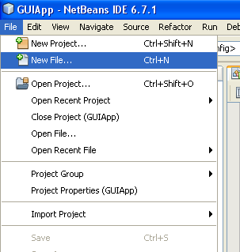
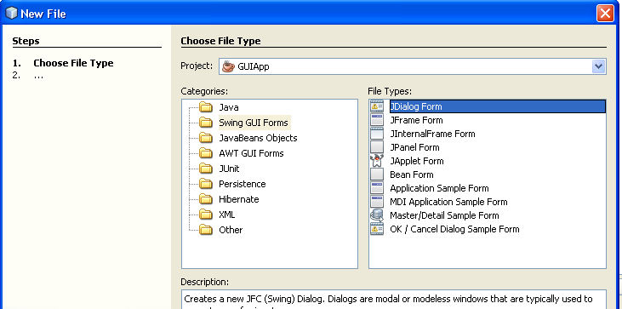
1.5 NetBeans GUI
Getting Started
To create a JFrame container
  NetBeans menu options select File -> New File
  In the dialog windows select Swing GUI Forms and then JFrame Form (in the right side window)
  Then, press Next
  A new windows is displayed.
    Enter CarsGUI as the Class Name
    Enter guiapp as Package Name
  Then press Finish
Dr. Cristina Muntean (NCI)
Notes:
Course description
September 2004
NCI BSHSS2 SWD3

Slide 24
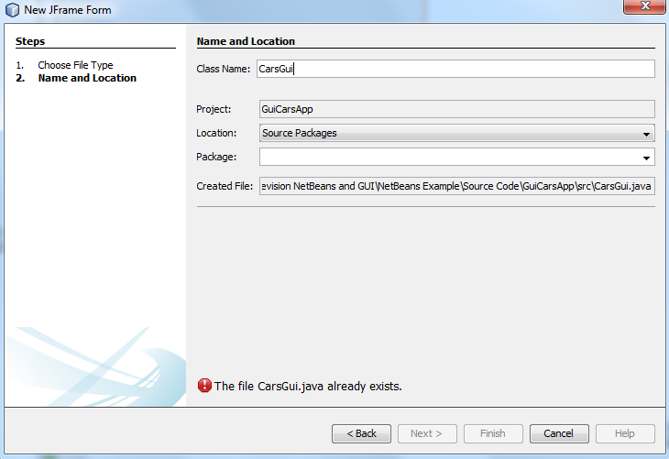
1.5 NetBeans GUI
Getting Started
To create a JFrame container (cont)
Set the name of the class that implements the JFrame form
  A new windows is displayed.
    Enter CarsGui as the Class Name
    Enter guicarsapp as Package Name
  Then press Finish
Dr. Cristina Muntean (NCI)
Notes:
Course description
September 2004
NCI BSHSS2 SWD3

Slide 25
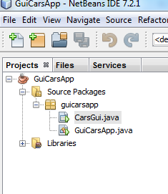
1.5 NetBeans GUI
Getting Started
The NetBeans IDE creates
  the CarsGui form
  the CarsGui class within the CarsGui.java application and
  opens the ContactEditorUI form in the GUI Builder
Dr. Cristina Muntean (NCI)
Notes:
Course description
September 2004
NCI BSHSS2 SWD3

Slide 26
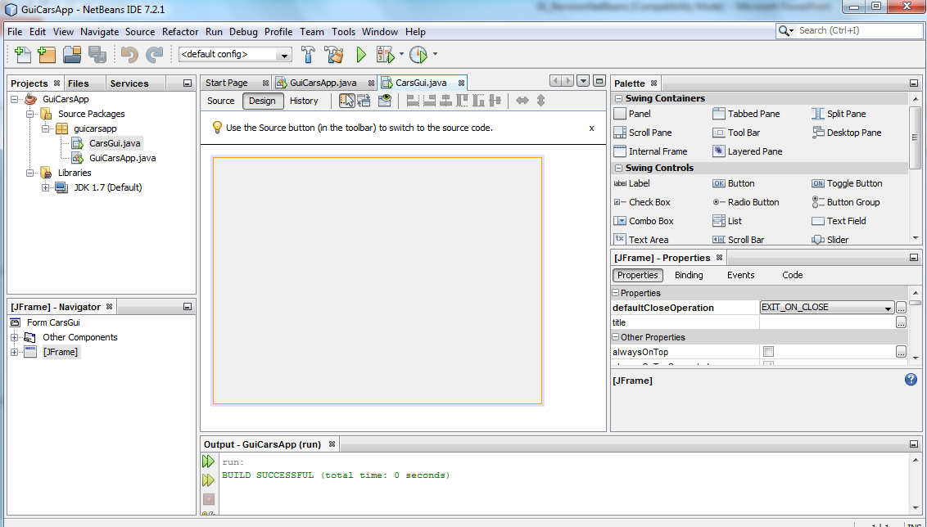
1.5 NetBeans GUI
GUI Builder Interface
Palette
Project
Design Area
Properties
Inspector
Dr. Cristina Muntean (NCI)
Notes:
Course description
September 2004
NCI BSHSS2 SWD3

Slide 27
1.5 NetBeans GUI
GUI Builder Interface
Design Area
  The GUI Builder's primary window for creating and editing Java GUI forms.
  The toolbar's Source and Design toggle buttons enable you to view a class's source code or a graphical view of GUI Form.
Inspector
  Provides a representation of all the components, both visual and non-visual, in your application as a tree hierarchy.
Palette
  A customizable list of available components part of JFC/Swing, AWT and JavaBeans components, as well as layout managers
Properties Window
  Displays the properties of the component currently selected in the GUI Builder, Inspector window, Projects window, or Files window.
Dr. Cristina Muntean (NCI)
Notes:
Course description
September 2004
NCI BSHSS2 SWD3

Slide 28
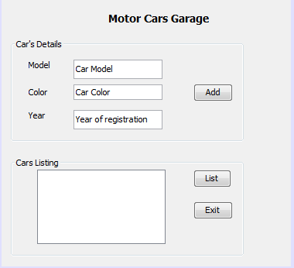
1.6 Developing a GUI for GuiCarsApp
How GUI should look like?
Dr. Cristina Muntean (NCI)
Notes:
Course description
September 2004
NCI BSHSS2 SWD3

Slide 29
1.6 Exercise – Developing a GUI for GUIApp
Adding components
Often helpful to sketch out the way you want your interface to look before beginning to lay it out.
Adding JPanel
  we've already added a JFrame as our form's top-level container,
  next step is to add a couple of JPanels which will enable us to cluster the components of our GUI using titled borders .
  In the Palette window, select the Panel component from the Swing Containers category
  Move the cursor to the upper left corner of the Design Area
  Resize the JPanel:
    Select the JPanel you just added
    Click and hold the resize handle on the right edge of the JPanel and drag
  Properties Window.
Add 2 JPanels in the Design area of your project
Add title borders to the JPanels
  Select the top JPanel element added, then in the Properties window, click next to Border property
  Select TitleBorder and then, fill in the Title as: Car’s Details
Dr. Cristina Muntean (NCI)
Notes:
Course description
September 2004
NCI BSHSS2 SWD3

Slide 30
1.6 Exercise – Developing a UI for GUIApp
Adding components
Adding Individual Components to the Form that will present information related to a car
  Car Model => we need a JLabel and JTextField
  Same fields for car’s color and registration year
Add a JLabel to the form
  In the Palette window, select the JLabel component from the Swing Controls category
  Move the cursor over the Car’s Details JPanel we added earlier and click to place the label
  Edit the display text of the JLabel: Double-click the added JLabel and type in Model.
Add a JTextField to the form
  In the Palette window, select the JTextField component from the Swing category
  Move the cursor immediately to the right of the Model JLabel and click
Dr. Cristina Muntean (NCI)
Notes:
Course description
September 2004
NCI BSHSS2 SWD3

Slide 31
1.6 Exercise – Developing a UI for GUIApp
Adding components
Adding Buttons to the form
  In the Palette window, select the JButton component
  Move the JButton in the lower JPanel (Display Info), right corner
  Double-click on the JButton and enter the text for its name.
Add 1 button to the Car’s Details JPanel, named Add
  Properties Windows -> Text to set the name on the button
Add 2 buttons to the Display Info Panel named: List and Exit
Add a JTextArea to the form
  In the Palette window, select the JTextArea component from the Swing category
  Move the cursor to the left top corner of the Display Info Panel
  Resize the JTextArea
Dr. Cristina Muntean (NCI)
Notes:
Course description
September 2004
NCI BSHSS2 SWD3

Slide 32
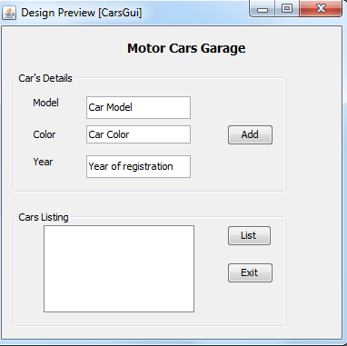
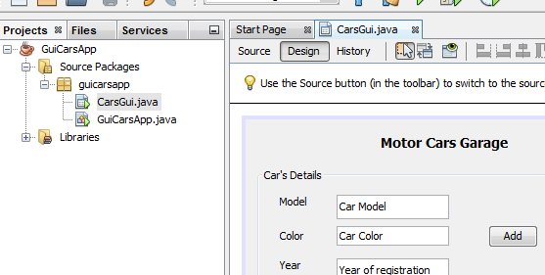
1.6 Exercise – Developing a UI for GUIApp
Previewing your GUI
Now that you have successfully built the GUI, you can try your interface to see the results
  clicking the Preview Form button in the GUI Builder's toolbar.
The form opens in its own window, allowing you to test it prior to building and running.
Dr. Cristina Muntean (NCI)
Notes:
Course description
September 2004
NCI BSHSS2 SWD3

Slide 33
1.6 Exercise – Developing a UI for GUIApp
Add Functionality to the Buttons
We are going to give functionality to the Add, List and Exit buttons
To give a function to a button, we have to assign an event handler
  use ActionListener responding to ActionEvent
Adding Functionality to Exit button
  Right Click on the Exit button. From the pop-up menu choose Events --> Action --> ActionPerformed.
  IDE will automatically add an ActionListener to the Exit button and generate a handler method for handling the listener's actionPerformed method
  The IDE will open up the Source Code window and scroll to where you implement the action you want the button to do when the button is pressed
  We are now going to add code for what we want the Exit Button to do
  private void jButton3ActionPerformed(java.awt.event.ActionEvent evt) { System.exit(0);
  }
Note that the Events --> Action --> menu contains more events you can respond to!
Dr. Cristina Muntean (NCI)
Notes:
Course description
September 2004
NCI BSHSS2 SWD3

Slide 34
1.6 Exercise – Developing a UI for GUIApp
Add Functionality to the Buttons
Adding Functionality to Add button
  Right Click on the Add button. From the pop-up menu choose Events --> Action --> ActionPerformed.
  IDE automatically adds an ActionListener to the Add button and opens up the Source Code window
  We are going to take user input from jTextField1 variable and display the string in jTextArea1 variable assigned to the GUI component.
  String carmodel;
  carmodel= jTextField1.getText();
  jTextArea1.append(“Car Model is:"+ c+”\n”);
  A data structure should be used to store/add the cars.
    We will do this task in the lab session
Dr. Cristina Muntean (NCI)
Notes:
Course description
September 2004
NCI BSHSS2 SWD3

Slide 35
1.6 Exercise – Developing a UI for GUIApp
Add Functionality to the Buttons
Adding Functionality to List button
  We need to use a data structure or collection type object (e.g ArrayList, Single Linked List, etc) to store the names (when pressing the Add button)
  Print all cars stored in the selected data structure
  We will do this task in the lab session
Dr. Cristina Muntean (NCI)
Notes:
Course description
September 2004
NCI BSHSS2 SWD3

Slide 36
1.6 Exercise – Developing a UI for GUIApp
Add Functionality to the Buttons
Last modifications to be able to run the application
  Add the following code in the GuiCarsApp.java, main() method
    public static void main(String[] args) {
    // TODO code application logic here
    CarsGui guicarsapp = new CarsGui();
    guicarsapp.setVisible(true);
  Compile the application (Build) and run the application
Dr. Cristina Muntean (NCI)
Notes:
Course description
September 2004
NCI BSHSS2 SWD3

Slide 37
Learning Outcome
What is IDE?
NetBeans IDE – Main characteristics
How to create, develop, compile, debug and run a simple java application developed in NetBeans
How to design GUI for a NetBeans project
Dr. Cristina Muntean (NCI)
Notes:
Course description
September 2004
NCI BSHSS2 SWD3

